Slide 1
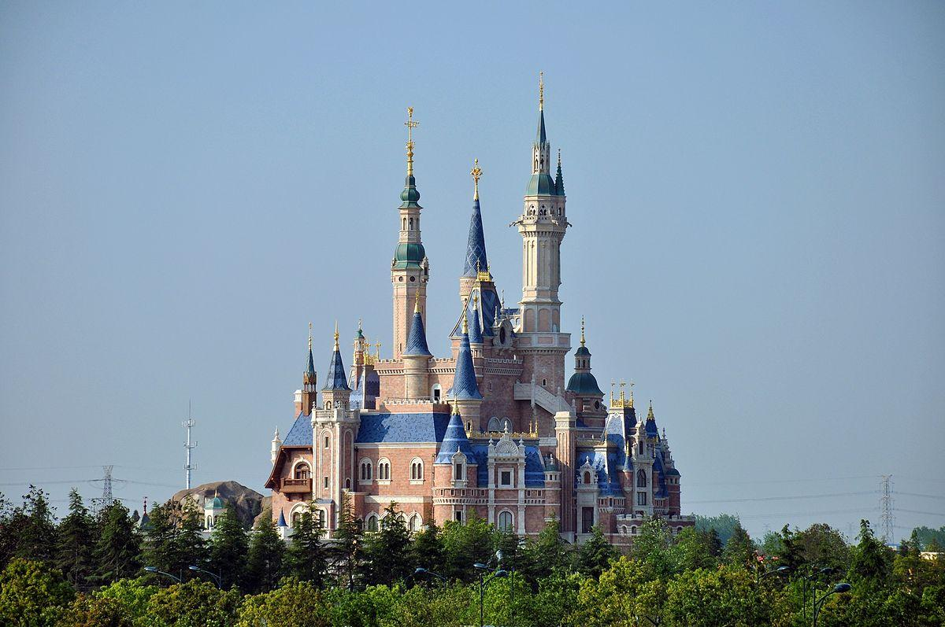
Disney Virtual Trip
Primary 1-3
This PowerPoint has all of your schoolwork for this week. All tasks are included in these slides which you can work through, Monday to Friday.
To support you to decide the level of task, please consider the following:
Early level (P1 and Mild for P2),
First level (P2 Spicy, P3 Hot)

Slide 2

Monday

Slide 3
Monday: IDL
Task: Enjoy the ‘It’s a Small World’ ride. The ride shows many countries and places around the world.
Early: Find out 2 facts about another country You could add photos/drawings/text to the template or record yourself saying what you have found out.
First: Compare Scotland with another country. You might think about: weather, food, attractions/scenery, events and celebrations, flags or anything else you are interested in. You could present your information in a poster or by speaking
https://www.youtube.com/watch?v=I2Do309e4YU
Learning Intention: I am learning about other countries and cultures.
Success Criteria:
Early: I can find out 3 facts about another country.
First: I can find out information about a country. I can think about how this compares to Scotland.

Slide 4
Monday: Reading
Watch the Frozen ride – how many words can you think of that rhyme with snow. Record yourself saying all of the words that you can think of.
https://www.youtube.com/watch?v=J8OHP9OriMA&t=33s
Challenge: Make a silly sentence using as many of the words as you can.
First level: Write down your list and create a silly story using lots of rhyming words.
Learning Intention: I am learning to produce rhymes.
Success Criteria:
Early - I can produce a rhyme.
First – I can write a silly sentence or story using rhyming words.

Slide 5
Tuesday

Slide 6
Tuesday: Writing
Watch the Monsters Inc ride clip, it is a 360 degree experience so you can drag the screen to see all around you.
Design your own monster and record yourself describing them. Are they kind, scary, fluffy, angry? Can you think of any other ways to describe them?
First level– Create a story where your monster is the main character.
https://www.youtube.com/watch?v=vDNUXa5sIHU
Learning Intention: I am learning to describe a character.
Success Criteria:
Early: I can create a character. I can describe the qualities of a character.
First: I can write a story with a main character.

Slide 7
Tuesday: Reading
Listen to ‘Under the Sea’.
https://www.youtube.com/watch?v=GC_mV1IpjWA
Early: Why does Sebastian think it is better to live under the sea? Record yourself explaining 2 reasons from the song.
First: Complete the above task and then think of reasons against living on land, if you were a sea creature, what would you say to a human? You could create your own short song/verse to convince Sebastian if you wish!
Learning Intention: I am learning to listen for understanding.
Success Criteria:
Early: I can listen carefully. I can recall information that I have heard.
First: I can recall information that I have heard. I can question what I have heard – do I agree? Is that really best?

Slide 8
Wednesday

Slide 9
Wednesday: Numeracy
On the next 3 slides you will find a snack menu from Disney Land.
Early: Circle the snack that you would like, and choose the correct coins to pay for it.
Challenge: How much change would you get if you paid with a 10p coin?
First: Circle 2 snacks that you would like, how much will it cost all together? Use the coins to pay for the items.
Challenge: How many ice creams could you get for 50p?
There are 3 slides, so you could do this 3 times. How much does it cost if you bought as many snacks as you would like?
Learning Intention: I am learning to use coins to make amounts.
Success Criteria:
I can use coins to make amounts.
I can give change.
I can add amounts together.

Slide 10

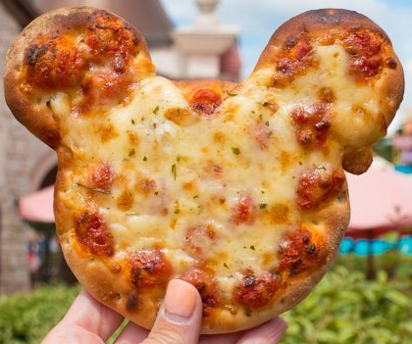
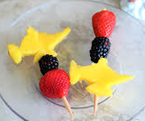
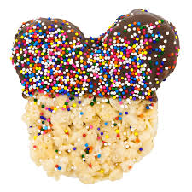
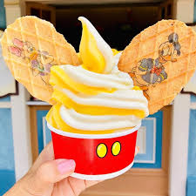
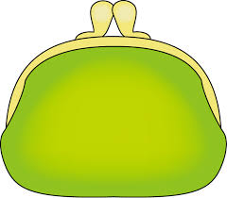
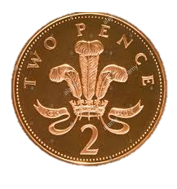
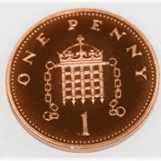
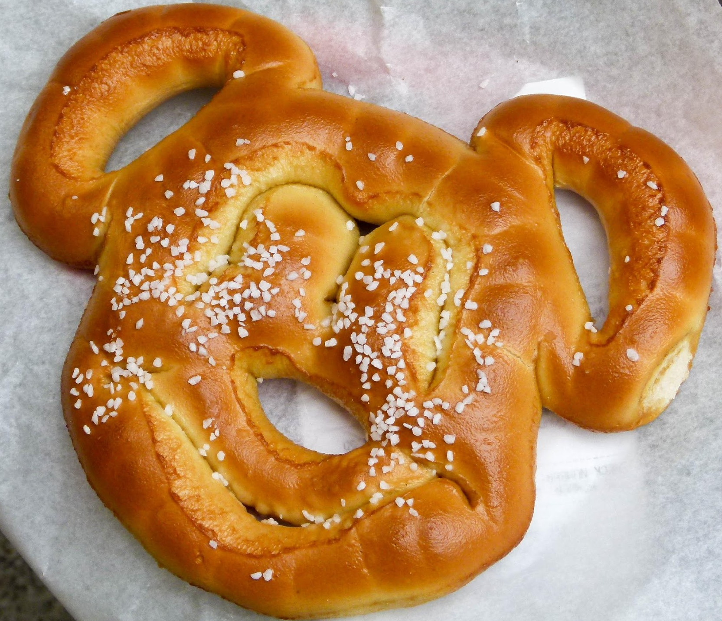
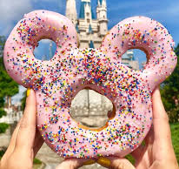
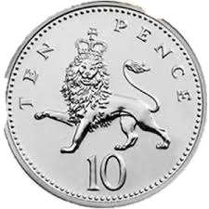

Mickey’s Snack Menu
Aladdin fruit skewers 5p | Pizza 7p
Ice cream 10p | Rice crispy treat 6p
Pretzel 4p | Doughnut 8p

Slide 11
Mickey’s Snack Menu
Aladdin fruit skewers 5p | Pizza 7p
Ice cream 10p | Rice crispy treat 6p
Pretzel 4p | Doughnut 8p

Slide 12
Mickey’s Snack Menu
Aladdin fruit skewers 5p | Pizza 7p
Ice cream 10p | Rice crispy treat 6p
Pretzel 4p | Doughnut 8p

Slide 13
Thursday

Slide 14
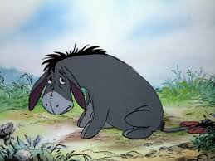
HWB
Eeyore is known for being sad sometimes. What could you do when you are feeling sad to make yourself feel a bit better?
Extension: How could you help a friend who was feeling sad? What things could a friend do to help you when you feel sad?
Learning Intention: I am learning to identify and manage my emotions.
Success Criteria:
I can explain ways that I could try to cheer myself up when I am sad.
I can think about how to help others too.

Slide 15
Writing
Enjoy the Toy Story ride. https://www.youtube.com/watch?v=_oqkZbkZ6gg
The Toy Story characters are all very good friends. Can you write a letter to one of your friends? You might want to tell them a piece of news, or what you enjoy doing with them.
Learning Intention: I am learning to write a letter.
Success Criteria:
P1: I can use “to” and “from”. I can sound out words. I can draw a detailed picture.
P2: I can write in sentences. I can use “to” and “from”.
P3: I can use joining words in my sentences, whilst remembering to include the same as P1 and P2.

Slide 16
Friday

Slide 17
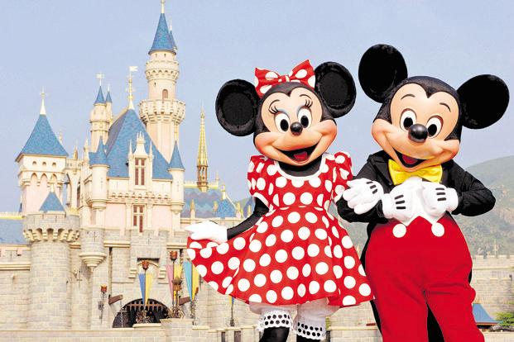
Create a souvenir photo! Take a close photo of your face and add it to the template as your souvenir!

Slide 19
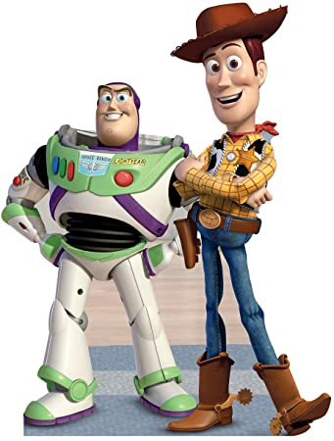

Slide 21
