Slide 1
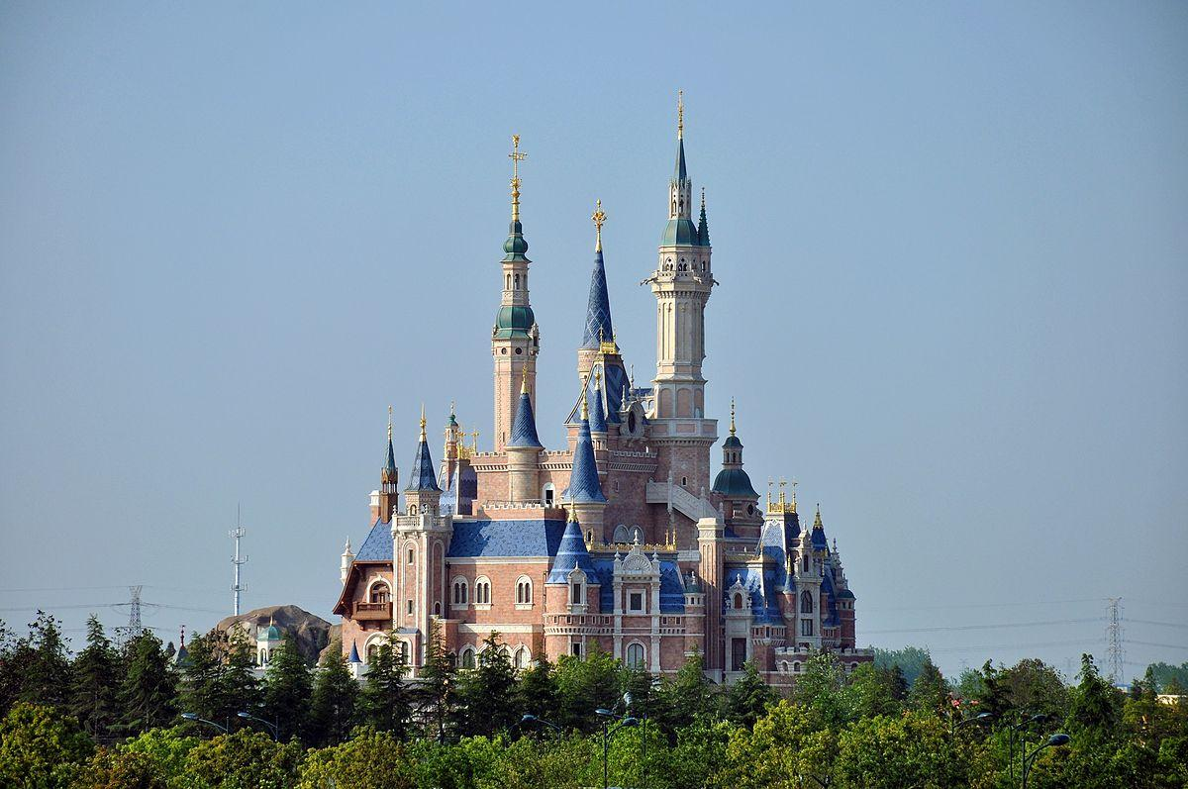
Disney Virtual Trip
Primary 1-3
This PowerPoint has all of your schoolwork for this week. All tasks are included in these slides which you can work through, Monday to Friday.
To support you to decide the level of task, please consider the following:
Early level (P1 and Mild for P2),
First level (P2 Spicy, P3 Mild)

Slide 2

Monday

Slide 3
Monday: Art
Create a passport that you can use during your trip! Remember to include a front cover, your name, a picture of yourself and lots of space for characters names! Each time you see a character this week in a ride, video or song, make sure to write their name in your passport! How many characters will you meet by the end of the week?
Learning Intention: I am learning to create an eye-catching design.
Success Criteria:
I can create a front cover.
I can include: my name and age.

Slide 4
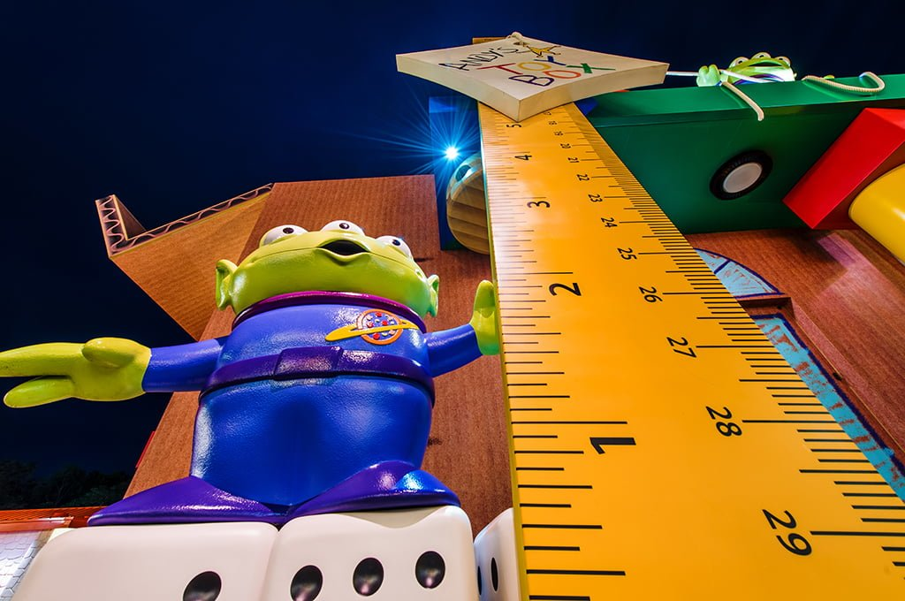
Monday: Numeracy
Get a toy figure or teddy…
To go on the rides your toy must be taller than:
6 pieces of cutlery
6 of your own shoes/socks
3 books
15 blades of grass
Estimate and then lay items out on the ground and measure whether your toy can is tall enough to ride!
Extension: If you have a measuring tape/ruler, you could measure how tall your toy is. Can you find
3 things that are taller and 3 things that are shorter than it? Measure the height of each thing.
Learning Intention: I am learning to measure and estimate height.
Success Criteria:
Early - I can estimate the height. I can measure carefully.
First– I can use a tape measure/ruler accurately. I can compare heights.

Slide 5
Monday: Writing
Take a tour of Donald Duck’s house boat. What can you see? Draw and label 5 things that you can see inside his house.
Challenge: Can you think of a story using Donald Duck’s house as the setting?
First level: Write about how Donald Duck’s house is different to yours, for example, my windows are not circles and I do not dry my washing on my roof!
https://www.youtube.com/watch?v=XERRGapwSVQ&t=17s
Learning Intention:
Early: I am learning to sound out words.
First: I am learning to write about a setting.
Success Criteria:
Early - I can draw in detail. I can sound out short words to add labels.
First – I can write in sentences. I can identify differences.

Slide 6
Tuesday

Slide 7
Tuesday: HWB
Safety Rules
Look at the video of Disney Land. Can you think of any rules or things that you would need to do to keep safe at the park? Think about what you should do on rides, who you would speak to and any extra rules that you can think of.
Extension/First level: Create a safety poster to display the rules.
https://www.youtube.com/watch?v=HyZfIlxwsfI
Learning Intention: I am learning to identify ways to keep myself safe.
Success Criteria:
Early: I can explain ways that I can keep myself safe.
First: I can explain how to keep myself and others safe. I can display my ideas in an effective way.

Slide 8
Tuesday: Numeracy
Look at the map of Disney Land (next slide). Can you find your way through the map?
1 Start at the Entrance and go to Donald’s house boat.
2 Start at the log flume and go to the rollercoaster.
3 Start at the pond and go to the Frozen ride.
First level: Can you give detailed directions on how to get from each place to the next. For example, “Turn left then go straight until you get to the pond”. Can you draw a map of your house?
Learning Intention: I am learning to read a map and give directions.
Success Criteria:
Early: I can use a simple map.
First: I can give detailed directions on how to get somewhere.

Slide 9
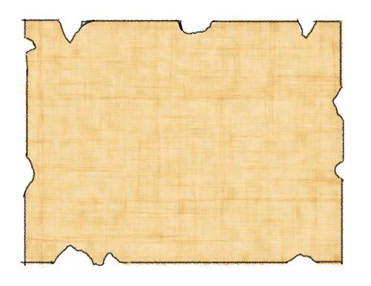
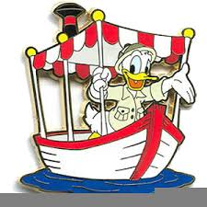

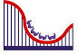
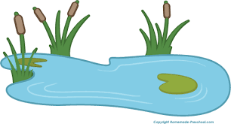
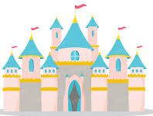
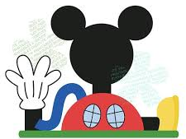
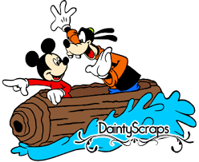

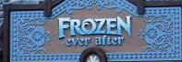

Slide 10
Tuesday: IDL
Early level: Weather Chart on next slide…
Disney Land is in Orlando in America.
Find out what the weather is like in Orlando today. How could you do this? Is it sunny, cloudy or windy? What is the temperature?
Early extension: What is the weather and temperature here? Is it hotter or colder?
First: How many degrees hotter/colder is Orlando than Drumnadrochit today?
Learning Intention: I am learning to identify and compare the weather in various places.
Success Criteria:
Early: I can identify the weather. I understand the weather is different around the world.
First: I can find out the temperature in various parts of the world. I can compare temperatures.

Slide 11
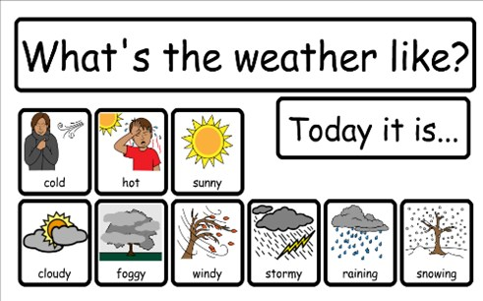

Slide 12
Wednesday

Slide 13
Wednesday: Reading
Early: Look closely at the pictures and see if you can spot any sounds/CVC words/common words. Record yourself saying the sounds or reading the words. You could create your own picture and hide words for somebody else to find. There are 3 pictures so that you can choose your challenge.
First: Look closely at the pictures and read the words with 3 letters. Practice each one in your red spelling jotter.
First challenge: Choose 5 words and write silly sentences with them. Can you grow these words?
Learning Intention: I am learning to read words.
Success Criteria:
Early: I can blend sounds to read words. I can read some common words.
First: I can read words using the spelling patterns that I have learnt.

Slide 14
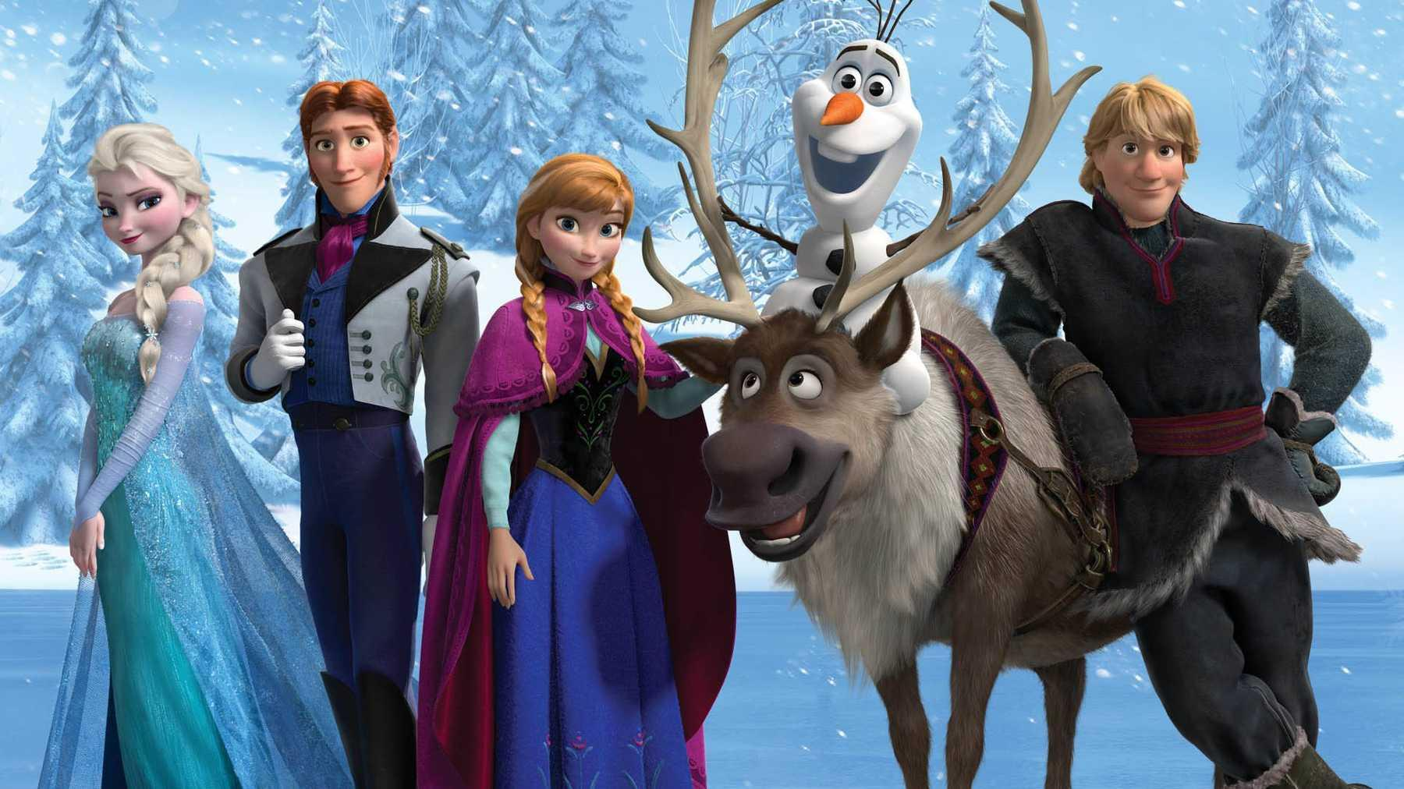
this
got
up
we
go
me
they
she
the
my
them

Slide 15
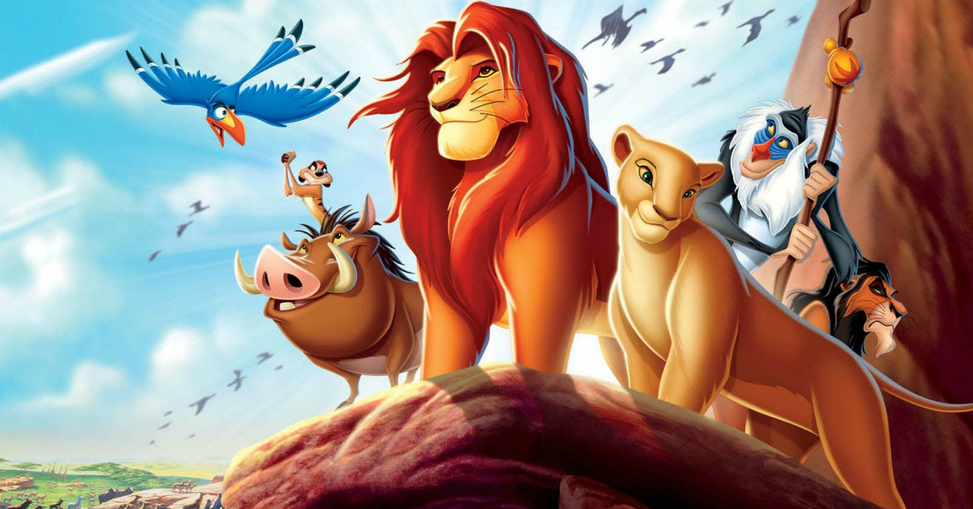
fly
bus
dog
log
leg
fan
red
fin
tin
gap
cub
rip
pig

Slide 16
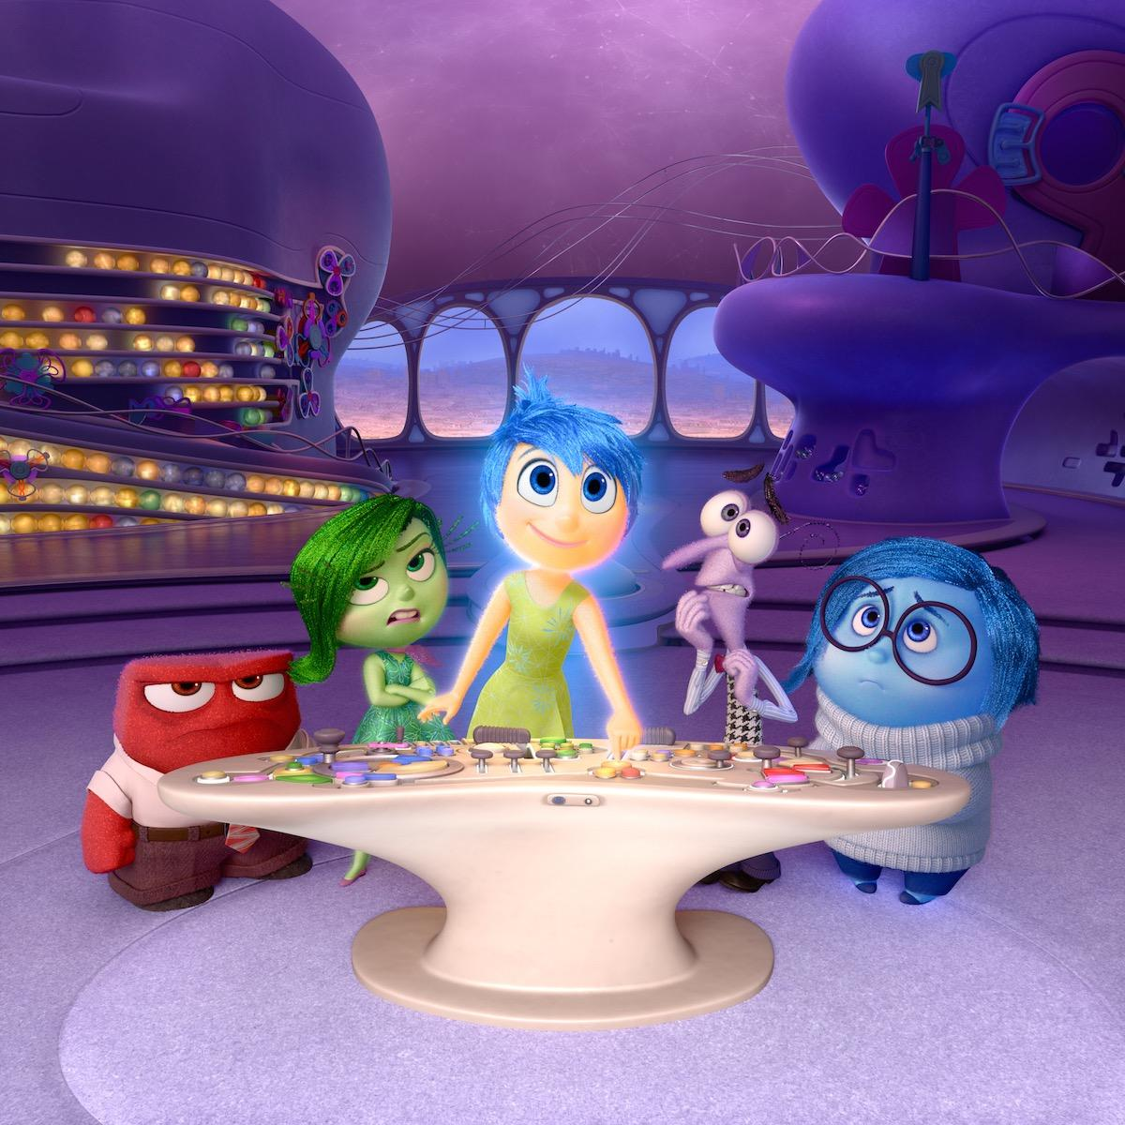
t
e
j
r
a
l
g
f
y
m
q
s
h

Slide 17
Wednesday: Writing
Early: Make a postcard to tell somebody all about your virtual trip to Disney Land! You will need to draw a detailed picture on one side and write your message on the other side. Challenge: Can you write the person’s address?
First: Write a diary entry about your day at Disney Land, remember to include what you did at various times throughout the day. How descriptive can you be?
Learning Intention: I am learning to share my experiences in a postcard/diary.
Success Criteria:
Early: I can share my experiences with others. I can write short words.
First: I can share my experiences. I can add detail to make my writing more interesting.

Slide 18
Wednesday: HWB
Watch the clip of Ratatouille (Mr Macleod’s favourite movie). Can you help to prepare a meal or snack today? You could look at a recipe with an adult if they are using one.
https://www.youtube.com/watch?v=jwLKPDJqldw
First level - Write down the recipe and instructions for somebody to follow.
Learning Intention: I am learning to prepare and cook food.
Success Criteria:
I can follow a recipe.
I can chop, peel and spread.
I can be safe in the kitchen.

Slide 19
Wednesday: IDL
Early: Mickey has asked for your help to design a new ride for Disney Land! You could draw your ride, video yourself describing it, or build it out of blocks, recycling etc. Have a look at the example to see Miss Cole’s rollercoaster in the garden.
First: As above and then you could make a poster to advertise your ride if you wish – remember to include the price, height limit and any safety rules that you have.
Learning Intention: I am learning to design a rollercoaster.
Success Criteria:
I can plan my design.
I can think about how to make the ride interesting.
I can think about safety features.

Slide 20
Thursday

Slide 21
Thursday: Reading
Can you read each character’s name? Can you match them to the correct pictures?
Challenge/First : Match the phrases to the correct pictures.
Learning Intention: I am learning to blend sound in order to read words.
Success Criteria:
I can blend sounds together.
I can match the words to the pictures.

Slide 22
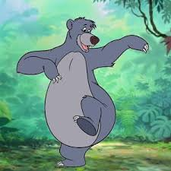
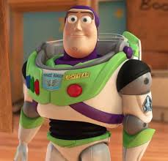
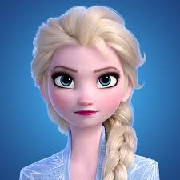
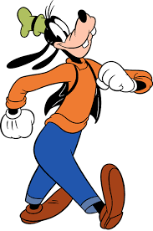
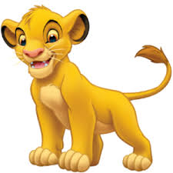
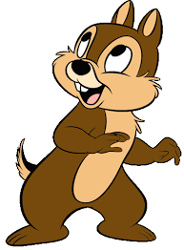
Elsa
Chip
Goofy
Simba
Baloo
Buzz

Slide 23
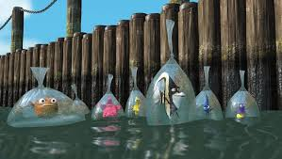
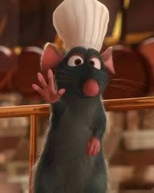
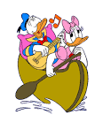
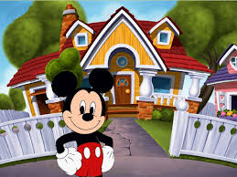
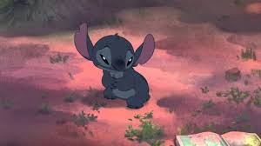
Match the phrases to the correct pictures.
Two ducks in a boat.
A mouse and his house.
There is a rat in a hat.
Stitch is sad.
The fish are in bags.

Slide 24
Writing
Task: We’re Flying Through the Air! Enjoy the Aladdin ride, where you fly through the sky on a magic carpet!
Mild: Can you draw pictures/make a list of things that can fly? Challenge: Write a sentence to tell me where you would fly to if you had a magic carpet.
Hot/Spicy: Where would you fly to on a magic carpet and why? Describe the setting using your most descriptive words! What would you see, hear, smell, touch and taste in the setting?
https://www.youtube.com/watch?v=fcbWb1FkSC0
Learning Intention:
Early: I am learning to write words.
First: I am learning to describe a setting.
Success Criteria:
Early: I can sound out words. I can form letters correctly.
First: I can use descriptive words. I can describe a setting to the reader.

Slide 25
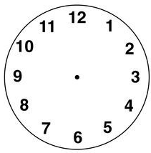
Numeracy: Mild
Draw the hour and minute hands to show the time.
The park opens at 9 o’clock.
You go on the log flumes at 11 o’clock.
You visit Mickey’s house at 4 o’clock.
Challenge: The park closes at half past 8.

Slide 26
Numeracy: Hot/Spicy
Draw the hour and minute hands to show the time.
The park opens at quarter past 9.
You go on the log flumes at half past 11.
You visit Mickey’s house at quarter to 3.
Challenge: The park closes at 25 past 8.

Slide 27
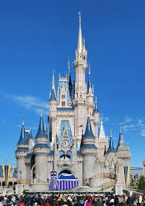
IDL
STEM
Look at the picture of Cinderella’s castle. Can you create your own castle using materials of your choice? You could use sticks, blocks, or anything else that you wish. Be as creative as you can!
Learning Intention: I am learning to build a design.
SC: I can select materials that will work for my design. I can create an interesting design. My design is stable and stays up.

Slide 28
Friday

Slide 29
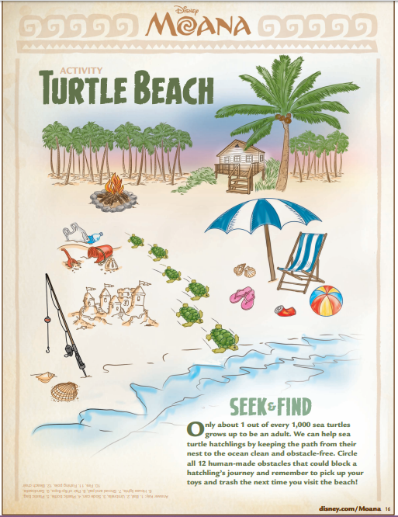
IDL
Look at this picture from the movie ‘Moana’.
Only 1 in 1000 turtles live to be adults, they need our help!
Can you help the baby turtle to get to the sea by pointing out all of the obstacles.
What do humans need to do when they are on the beach to keep turtles safe?
First Level: Can you make a leaflet or poster to tell beach-goers how they can protect the environment?
Learning Intention: I am learning to care for the planet and its animals.
Success Criteria:
I can identify risks to the turtles.
I can explain what we can do to look after the turtles/planet.
I can present my ideas clearly through a recording or poster/leaflet.

Slide 30
Reading
Watch the clip from ‘Moana’ and answer the questions:https://www.youtube.com/watch?v=KGqBfyQFG_g
What did Moana find on the beach?
Where did the turtle go?
Why did Moana want to go back to the beach?
Make sure you write your answers in sentences. You could think of a question to ask somebody else, to check that they were watching carefully!
Learning Intention: I am learning to answer questions about what I have seen/heard.
Success Criteria:
I can watch and think carefully about what is happening in the clip.
I can answer questions about what I have seen.
I can create my own questions.

Slide 31
Numeracy
Early: Mickey Addition
Draw yourself a Mickey addition board, like in the example.
Gather some materials to help with your addition – blocks, buttons, rocks etc. Roll a dice and put that many blocks in his ear, roll again and put that many blocks in his other ear. How many are there all together?
Challenge: Write down your sums.
First: Mickey Place Value
Draw yourself a Mickey place value board, like the example. Have an adult choose a number between 10 and 50. Put the number in the middle of the board and use the ears to show how many tens and units the number is made up of.
Learning Intention: Early: I am learning to add numbers together. First: I am learning to build numbers using tens and ones.
Success Criteria:
Early: I can count carefully. I can use strategies to help me add numbers, such as: number lines, objects or my fingers.
First: I can split a number into its tens and ones.

Slide 32
HWB
Watch the video of the parade. Can you join in with any of the dancing?
https://www.youtube.com/watch?v=rR-KP8KH1Ng
Learning Intention: I am learning to follow movements that I see.
Success Criteria:
I can follow movements.
I can create my own dance.

